Slide 1

Chapter 10
Incentives
Duygu ABADAN

Slide 2
Introduction
In the previous chapters:
We do analysis wrt strategy, environment, configuration, task design, people, leadership, climate, coordination and control.
Now, another vital component to the design of the company: “incentives”. What do we mean by incentives?
Incentives are means or certificates designed to encourage certain actions or behavior on the part of employees, or groups of employees.
Incentives are not just the objective set of rewards that the firm offers but also the way people interpret the rewards and act upon the rewards that the firm provides.

Slide 3
Introduction (cont.)
Different types of incentives:
Monetary rewards (salary, wage, benefits)
A promotion or title in the company
Praise, acceptance, belongingness, and recognition of self worth.

Slide 4
Introduction (cont.)
Incentives must be internalized by people so that they accept the incentives, consider the incentive to be fair and are motivated to do well.
Incentives will be viewed as fair if people think the reward is reasonable for the level of effort, and also if the reward is consistent with the rewards offered to other individuals or groups nearby.

Slide 5
Introduction (cont.)
Alignment of incentives with organizational goals can be problematic and many organizations get it wrong:
Example: Consider a company trying to be fair to its employees in a downturn and so devises a scheme whereby the employees get six months’ pay if fired, but nothing if they leave voluntarily.
What is the problem with the case above?
→ They will begin to work in such a way so as to be fired !!

Slide 6
Introduction (cont.)
These are unintented consequences of good intentions on the part of management.
Put yourself in the position of the employee and think about all of the things you might do in response to an incentive offered by the organization.
Being fired can be in the individual’s self-interest, but it is not in the firm’s best interest!

Slide 7
Introduction (cont.)
A traditional view of incentive design has taken a control perspective, that is, designing incentives so that they control either the behavior of employees or the result of what managers or employees do.
Controlling behavior: involves monitoring the individual, i.e., how work is done.
Controlling results: involves monitoring the outcomes once work is completed.

Slide 8
Introduction (cont.)
You can influence the activities of the employees in an organization in three ways:
You can tell them what to do
You can set behavioral rules that specify what they should do in certain situations.
You can create an incentive system that indirectly influences your employees to do what you want them to do.

Slide 9
Introduction (cont.)
These 3 ways of controlling the activities of the employees should be seen as a package.
For example, there may be a rule that says what to do and an incentive system whereby the employees are rewarded if they follow the rule well.
There may also be a central decision authority that tells the employees which set of rules to invoke in a particular situation.
Or the employees can be given a freedom to make decisions about how to do their job, but their performance is evaluated on the basis of the outcome on which you are rewarded.

Slide 10
Introduction (cont.)
Result-based incentives put the risk on the employee and thus may include elements outside the control of people in the organization. (owners of sports team who evaluate coaches based on their winnings record)
→ basis for “agent theory”, where the principal gives some of the risk to the agent.
Behavior-based incentives: employees take no risk on the results. Employees are not responsible for bad decisions , bad luck, or unforeseen events in the environment that they cannot control. (call center)

Slide 11
Introduction (cont.)
Why would an individual assume some of the risk in an organization?
Higher risks bring higher amount of compensation. Top managers are given large compensation packages in high risk firms for that reason.
Also, people vary in their risk preferences, and one’s cultural background may affect willingness to take risks. So it may be appropriate to let some employees or business units assume more risks than others. For example, younger workers or entrepreneurs may prefer large risks; and research and product development groups may prefer large risks relative to other departments.
If an individual is to assume some risk, the individual should have the necessary skills and knowledge to understand and adapt to the uncertainty.
Individual should be given authority to make the appropriate decisions in the course of carrying out his or her work tasks.
If decisions are delegated, the incentives should be aligned so that they support the organization’s goals of efficiency and effectiveness.

Slide 12
Introduction (cont.)
The individual in the organization is affected by the particular incentives that organization offers.
Therefore it is important to design incentives system in organization that aligns with organizational goals
Fundamental design choice is whether to base incentives on behavior or results. This design dimension will be basis of evaluation of the work
Behavioral-> focus on procedures: compliance with standards, rules and routines.
Results-> focus on outcomes: the effectiveness

Slide 13
Introduction (cont.)
Another (second) fundamental design choice is the target of incentives, that is, whether to base incentives on individual or group work performance.
Whether work incentives are individual or group-based depends on your unit of analysis.
If your unit analysis is a team then you can design incentives for the individual team members or for the team as a whole.
If your unit of analysis is a large organization then you could reward each division or subunit based on its behavior results (individual) or based on their collective (group) behavior or results.

Slide 14
Introduction (cont.)
Using two dimensions of incentive systems design:
Basis of Evaluation
Target of Incentives
We can outline a typology of four distinct types of incentive systems: personal pay, skill pay, bonus-based, and profit sharing.

Slide 15
The incentive system design space.
Target of Incentive
Group
Skill Pay
Profit Sharing
Basis of Evaluation
Behavior
Results
Personal Pay
Bonus-based
Individual

Slide 16
Personal Pay
A personal pay approach to incentive design is based on the behavior of the individual.
It is an agreement between the individual and the boss or organization
The personal pay approach does not emphasize results or outcomes, but instead emphasizes individual compliance with rules or directives.
Rewards are designed with “doing work the right way”.

Slide 17
Personal Pay (cont.)
Employee behavior is measured in terms of showing up at a particular time and then working for a number of hours.
The measurement of the behavior is often done by “clocking in” and “clocking out”.
There may be job description with particular rules that the individual has to follow.
Within the rules given, individual follows the directions of the boss and does things as requested.

Slide 18
Personal Pay (cont.)
The actual pay is negotiated, and there can be significant differences between persons or groups doing the same job.
There is a focus neither on efficiency nor on effectiveness, as the most important thing for employees is to follow rules and directives.
Personal pay reward system requires that the environment does not change too often and that the organization has chosen the right rules to follow.

Slide 19
Personal Pay (cont.)
Personal pay reward system assumes that the people being evaluated have the kind of personality that can accept and function within such a reward system.
Dynamic risk seekers will have a difficult time with such incentives.
Actual pay level tend to be lower than that in other incentives systems as it is the organization or firm that assumes all the risk.

Slide 20
Skill Pay
Most widely used incentive system in the modern world
Pay differentials are skill or position based rather than results-based.
Salaries are determined by individual skills or particular position or job in the organization.
Skill is measured in terms of formal education and seniority which incorporates the ability to perform certain tasks.
One can receive an increase in salary by getting more formal education or staying in the same organization for years.

Slide 21
Skill Pay (cont.)
Although rewards are related to the individual, the pay is based on belonging to a particular group described by seniority, rank and education.
This incentive system is based on the idea that people should utilize the requisite skills and follow job description, rules, and the policies of the organization.
Under this incentive system it is assumed that people will accept direction from the organization’s authority, usually the hierarchy, on how to do their work

Slide 22
Bonus-Based
A bonus based incentive system changes the focus from the behavior to the results (from process to outcome).
Usually, bonus is “in addition to” the normal pay as skill-based.
Goals are set for employees and rewards(pay, promotions) are distributed based on performance which is compared to pre-established targets or goals.

Slide 23
Bonus-Based (cont.)
An example to bonus-based incentive system:
‘Top manager’s salary is dependent on the profit of the organization or, if it is a public traded company, on stock value.’
Although this systems are recommended by many stock analysts, they have many unwanted side effects.
They may trigger unethical or even illegal behavior on the part of executives to get the expected results when results don’t come out as desired.
There can also be a tendency to hide bad news from superiors providing rewards.

Slide 24
Bonus-Based (cont.)
The advantage of a bonus based incentive system is its flexibility for the organization.
Organization can ask the individual to do whatever is needed to be done. (little planning)
Bonus aspect of the contract normally doesn’t have a long-term commitment by the organization.
Organization can change its requests on short notice, terminate the relationship, or renegotiate the bonus aspect of the contract.
(Cisco, the maker of network routers → increase productivity during period of peak demand)

Slide 25
Profit Sharing
The basic idea is similar to bonus-based incentives that tie compensation to results rather than behavior.
People are rewarded on the basis of effective collaboration with others to yield high performance on the part of the group.
Profit sharing is not only giving a fixed bonus but also a share in the profits to all members of unit.
It is more group-based than individual-based.

Slide 26
Profit Sharing (cont.)
For the profit sharing scheme to work, people should feel that individual performance can make difference for the group outcome.
Task must depend upon joint efforts of everyone in the target group.
The profit sharing incentive system is appropriate when results are based on different individuals coordinating their skills and knowledge; and where excellent individual performance is not sufficient.
Team-based sports illustrate how this type of incentive system can be beneficial.
Successful teams require not only highly talented players but also effective collaboration among teammates to yield high performance on the part of the group. (Michael Jordan, Washington Warriors)

Slide 27
Profit Sharing (cont.)
The smaller the target group the more likely the profit-sharing scheme will have the anticipated effect.
In large firms individuals cannot see the effect of their efforts on the organizational performance.
A so-called free rider problem can result, with some people relying on the skills and success of others to carry the group to success.
On the other hand, the profit sharing approach can be very effective if people believe their contributions to group efforts “matter”, so they are committed to working together with colleagues, and they view the incentive scheme to be fair.

Slide 28
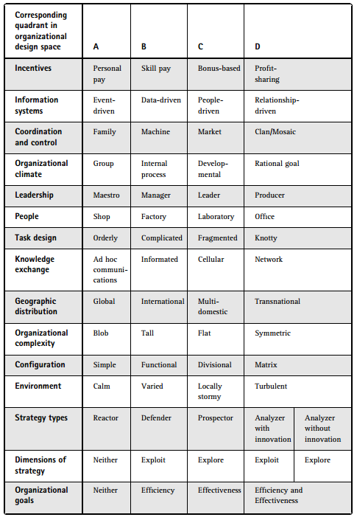
Fit and Misfits

Slide 29
Thank you ☺

